Slide 1
The Leaky Bucket: Generational Tenure Analysis & Strategy
Portfolio Case Study
Prepared By: Joy Lorna
Date: January 22, 2026

Slide 2
Closing the Gap: A Data-Driven Roadmap for GenTech Retention
Client Background:
GenTech Solutions is a prominent technology firm known for its software development and IT services, currently grappling with employee retention issues characterized by a "leaky bucket" in its talent pipeline. Despite aggressive hiring practices, the company's 12-month retention rates are inconsistent. Leadership attributes this problem to an ineffective "one-size-fits-all" HR policy that does not cater to the diverse requirements of various generational groups, specifically the distinct needs of Gen Z developers compared to Baby Boomer project managers. This generational disparity is a key factor in the company's challenges regarding modern workforce solutions and employee retention.

Slide 3
Primary Objective:
To explore generational trends in employee performance, retention, and satisfaction to guide the development of targeted, data-driven HR strategies.
Target Audience:
HR Department and Executive Leadership Team.
Analysis Objectives:
Analyze turnover employee tenure across generational cohorts.
Identify key factors contributing to job satisfaction and attrition.
Provide actionable recommendations tailored to each generation.

Slide 4
Executive Summary
GenTech’s one-size-fits-all HR policy is failing our most vulnerable talent. In Software Engineering, Gen Z employees churn out at the 12-month mark despite heavy training investments. To plug this leak, we need a targeted, milestone-based retention strategy zeroing in on the 10–14 month window for technical and younger staff.
Analysis uncovers a generational retention crisis:
Baby Boomers and Gen X stick around longer, dominating leadership and admin roles, while Millennials and Gen Z bolt early—especially in the first year and technical/production teams.
Gender gaps are negligible in older groups but widen among the young, with women exiting sooner. Attrition hits low performers and stars alike, squandering top talent.
Uniform training spends yield no tenure gains for younger cohorts, demanding tailored engagement, career growth, and retention tactics for Gen Z and Millennials.

Slide 5
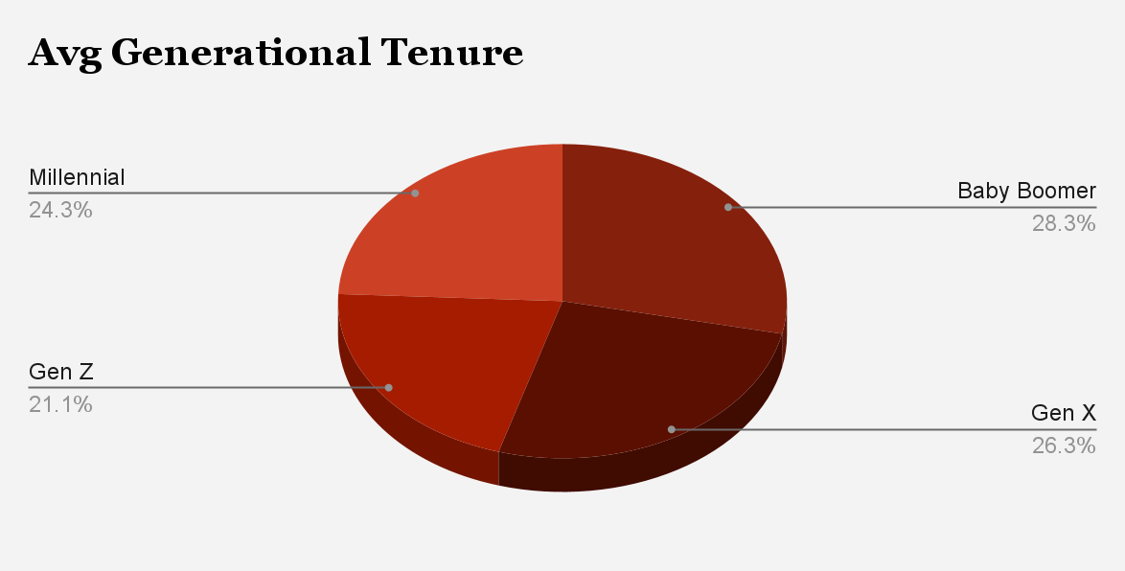
Tenure by Generation
Baby Boomers recorded the highest average tenure at 18.37 months, with some remaining for up to 44.4 months, while Gen X followed at 17.03 months. Millennials averaged 15.74 months, and Gen Z showed the shortest tenure at just 13.70 months, highlighting faster departures from the organization, with certain individuals leaving after only 2 months.

Slide 6
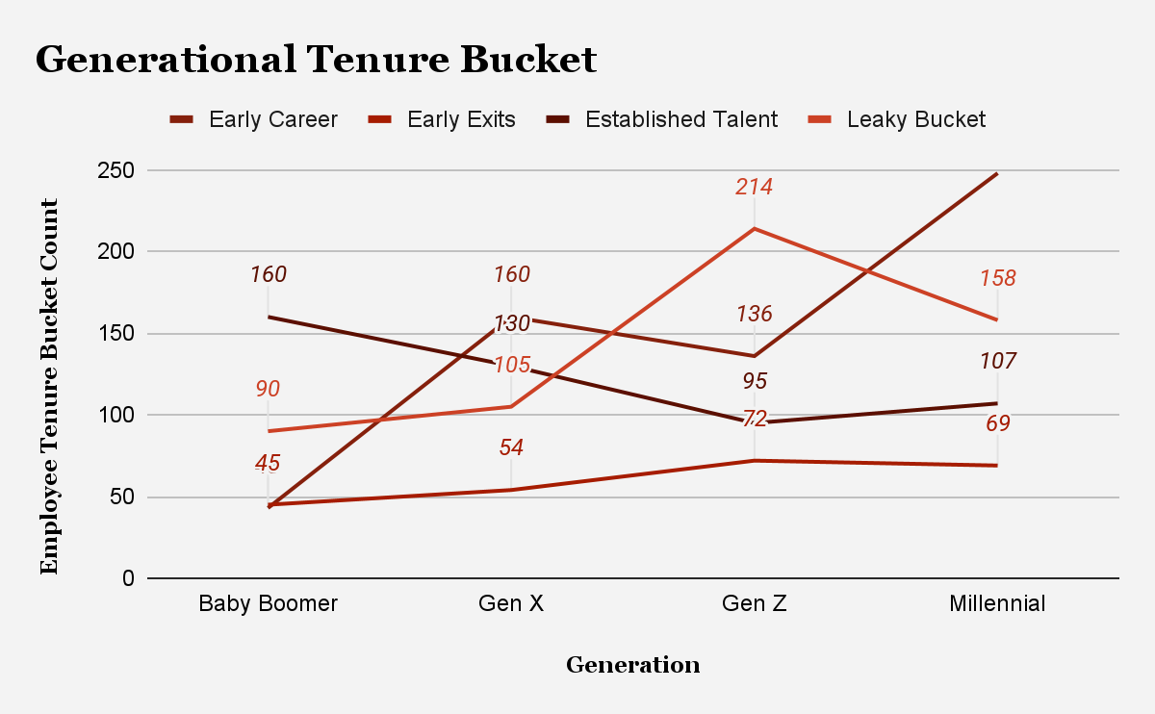
Tenure Buckets
The findings indicate that Gen Z has the highest number of "Leaky Bucket" exits at 214 employees, suggesting difficulties in retaining this demographic beyond their first year. Millennials, however, account for the overall largest volume of exits at 582, revealing a trend where younger generations leave earlier in their employment. A total of 286 Gen Z and Millennial employees exited within the first year, contrasting with Baby Boomers and Gen X, who exhibit better long-term retention, indicating a generational gap in early career retention.

Slide 7
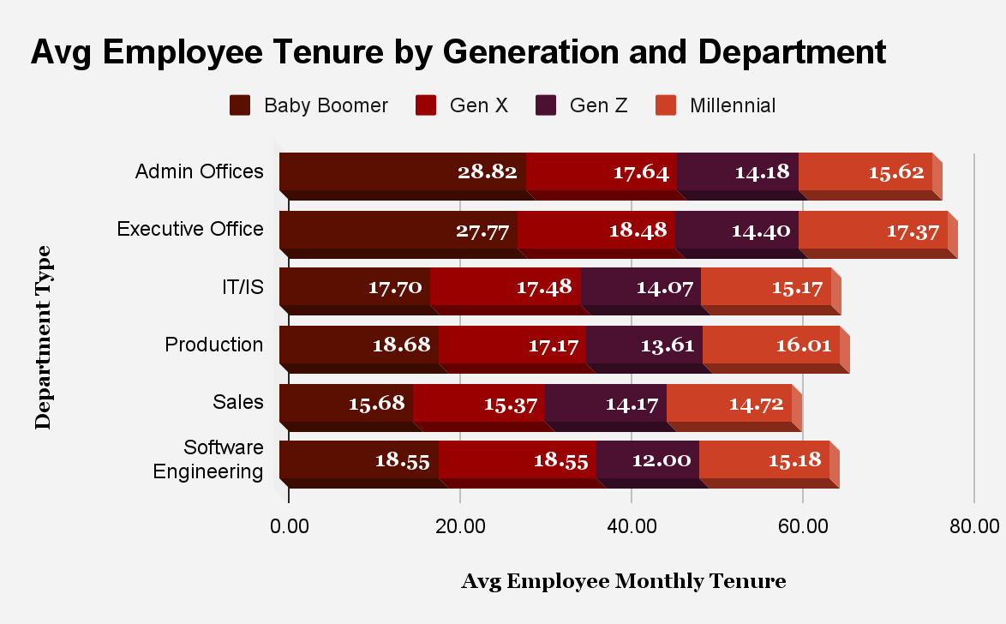
Departmental "Danger Zones"
Baby Boomers have the longest tenures in Administrative (28.82 months) and Executive Offices (27.77 months), while their tenure in Sales is shorter (15.68 months). Gen X averages 17–18 months, favoring Executive and Software Engineering roles. Gen Z has the shortest tenures, particularly in Software Engineering (12.00 months) and Production (13.61 months), suggesting quick exits. Millennials peak in Executive Office tenure (17.37 months) but see declines in Sales (14.72 months). Older generations stay longer in administrative roles, while younger cohorts exhibit early departures, emphasizing a need for better retention strategies. Low turnover rates for Gen Z in Software Engineering contrast with high turnover in Sales across all generations.

Slide 8
Tenure by Gender, Performance and Satisfaction
In older generations, tenure is balanced across genders, but in younger cohorts, males have a longer average tenure than females. Specifically, Gen Z males average 14.32 months while females average 13.16 months, indicating a retention gap for younger female employees. In contrast, among Millennials and Gen X, males also show slightly longer retention than females.
Gen Z exhibits a notable count of "Strong Performers" (82), but their departure poses a significant financial and intellectual burden for GenTech. In total, 941 employees rated as Competent left, alongside 339 Developing and 264 Strong Performers. Alarmingly, 172 Outstanding performers also exited, indicating attrition affects all performance levels. Gen Z led in departures among Competent and Outstanding categories, highlighting the potential loss of skilled young talent.

Slide 9
Recommendations
1. The "Software Engineering" Intervention (Target: Gen Z)
The Issue: Gen Z exits technical roles at exactly the 12-month mark (average 12.0 months).
Recommendation: Implement a "First-Year Milestone" Bonus or Promotion Track.
Action: Introduce "Junior Developer II" titles or skill-based pay bumps at the 10-month mark to incentivize Gen Z to stay past the critical one-year "leak" point. Provide a clear 24-month career roadmap during onboarding.
2. Mentorship & Knowledge Transfer (Target: Baby Boomers)
The Issue: High stability in leadership but high replacement cost.
Recommendation: Launch a Reverse Mentorship Program.
Action: Pair Baby Boomers (who have 27+ months of tenure in Admin/Executive roles) with Gen Z new hires. This rewards Boomers with a "Legacy" role and provides Gen Z with the professional connection they lack, potentially increasing tenure for both.

Slide 10
3. Career Flexibility & Growth (Target: Millennials)
The Issue: Largest volume of exits (582) and low tenure in Sales.
Recommendation: Internal Mobility & "Work-From-Anywhere" Credits.
Action: Since Millennials are often in a "mid-career" phase, offer internal rotation programs to different departments (e.g., moving from Sales to IT/IS) to prevent stagnation without them leaving the company.
4. Training ROI Optimization (Company-Wide)
The Issue: Equal spending on training ($561) across all generations despite vastly different retention periods.
Recommendation: Phased Training Investment.
Action: Instead of front-loading all training costs in the first 3 months, spread the budget across the first 18 months. Offer "Advanced Certification Credits" that unlock only after 14 months of tenure to encourage employees to stay to "claim" their full training value.
5. Gender-Specific Engagement (Target: Gen Z Females)
The Issue: Female Gen Z employees leave nearly a full month earlier than males.
Recommendation: Targeted ERGs (Employee Resource Groups).
Action: Establish a "Women in Tech" mentorship cohort specifically for new hires in Software Engineering and Production to address the early exit trend among Gen Z women.

Slide 11
Overall Strategic Direction
To solve the 'Leaky Bucket,' GenTech must stop treating the workforce as a monolith. The company should adjust its Software Engineering approach by emphasizing 10-month retention milestones and utilizing Executive Baby Boomers as mentors. This strategy aims to safeguard the average training investment of $556 and extend the current 16-month employee lifecycle. Key focus areas include enhancing early-career retention, promoting gender equity, and implementing department-specific strategies while ensuring training efficacy and leadership continuity. By tackling the rapid turnover of younger staff and affirming the value of high-performing employees, GenTech can lower attrition rates, boost engagement, and establish a more sustainable talent pipeline.

Slide 12
Q&A

